Slide 1
LET'S CELEBRATE!
NATIONAL AND LOCAL FESTIVITIES CELEBRATED
IN MAY

Slide 2
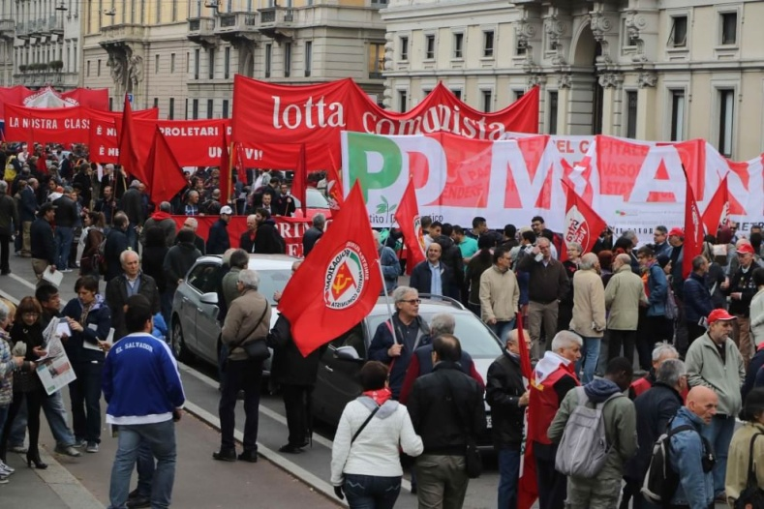
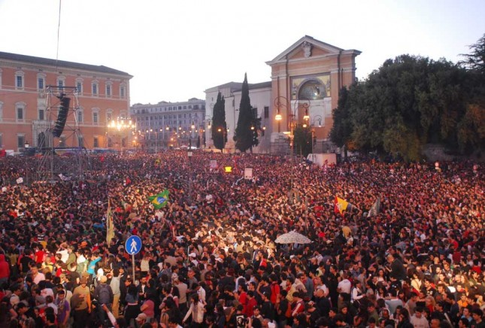
1st of May
The first of May is Labour Day and it is a national holiday. On this day old the workers don't go to work and schools are closed.
In the main cities there are demonstrations of the trade unions.
In Rome the trade unions organize a free concert with the most popular rock and pop stars.

Slide 3
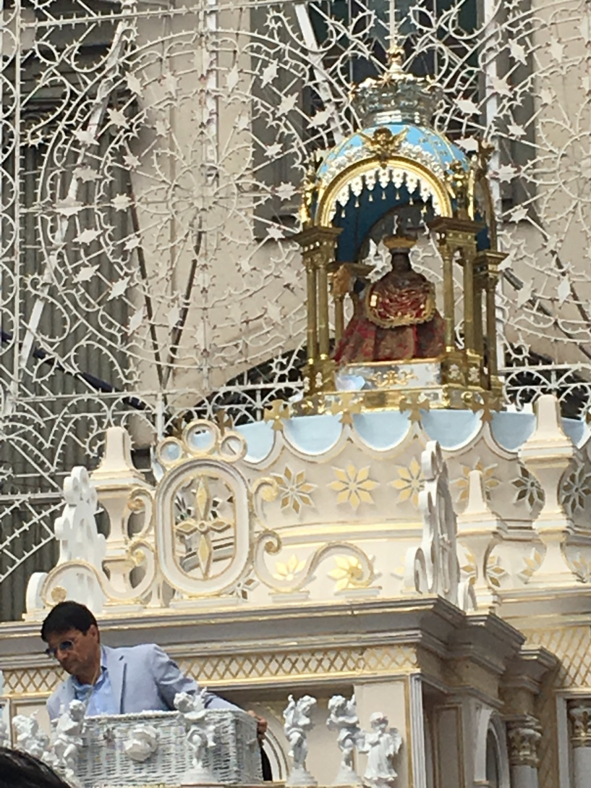
Our Lady of Peace
In our town, in May, there is a very popular festivity: Our Lady of Peace.
The cult of Our Lady of Peace derived from a popular legend: the discovery of a statue of the Virgin, which was transported from Byzantium to Campania, near Cuma.
The statue was found by two farmers who had oxen, which knelt when they saw the statue.
The statue was then transported to Giugliano, where afterwards a church was built.
In 1739 the Vatican recognized Our Lady of Peace as Patroness of Giugliano and ordered the festivities, which are now held from the Vigil of Pentecost until the following Sunday.

Slide 4
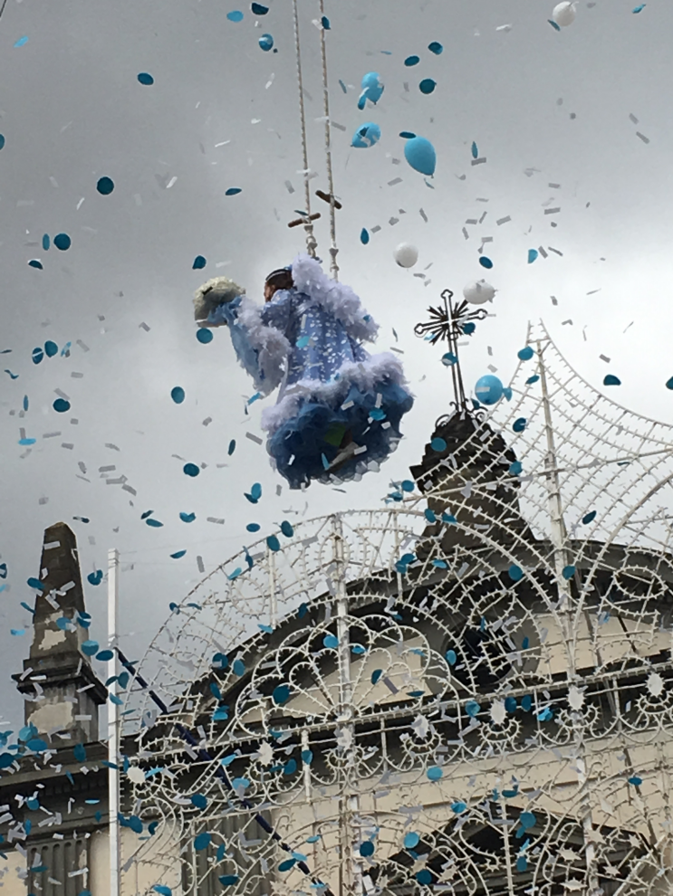
The Flight of the Angel
A very important part of the festival is the flight of the angel who comes to four girls, chosen annually from among those who have requested it, in turn they represent the archangel Gabriel.
Each angel is suspended in the air with special cables, stretched between the church and a building and falls slowly toward the statue of Our Lady.
During the descent, the girls sing traditional songs, recite poems and scatter petals in honour of Our Lady of Peace. This function is repeated twice, at the entrance and at the exit of the statue from the church.

Slide 5
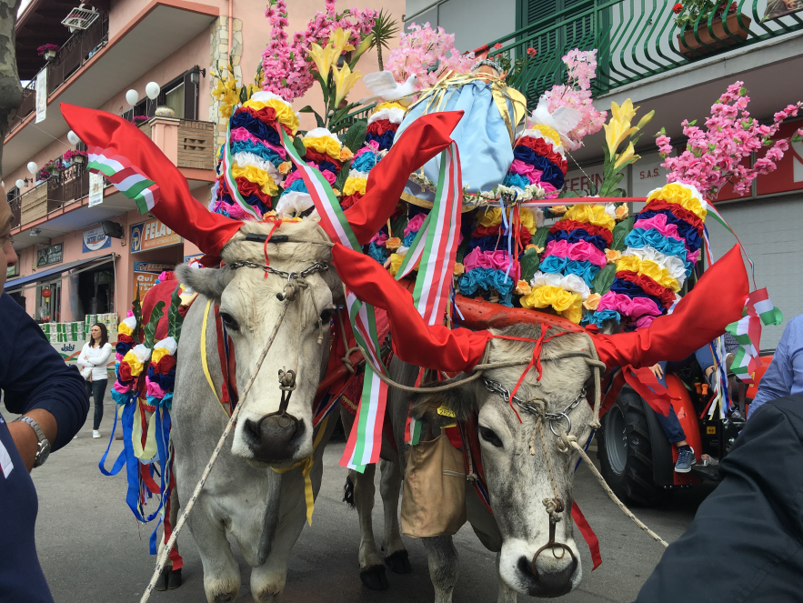
The Procession
Then there is a long procession in the streets of Giugliano.
The statue of Our Lady is put on a beautiful chariot pulled by two oxen decorated with flowers.

Slide 6
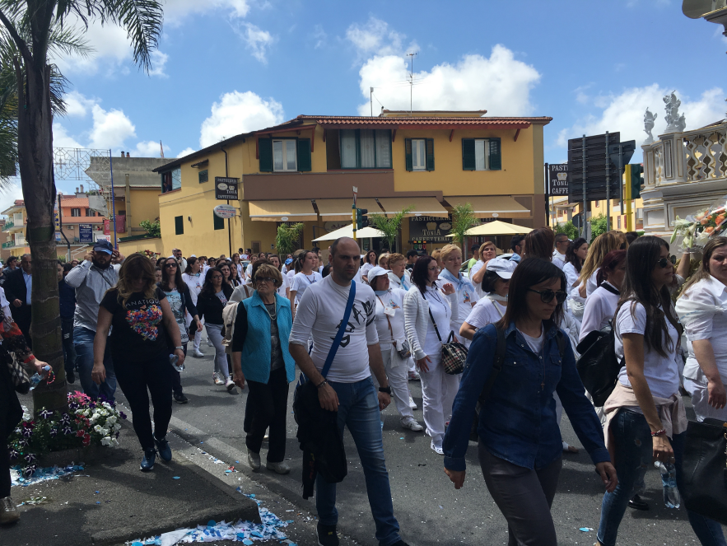
The Girls dressed in White
Behind the oxen there are girls dressed in white who sing and pray the Virgin Mary.
On the last night of the festivity there are spectacular fireworks.

